Slide 1
ATLIQ Hardware
This presentation contains the analysis for the business questions asked by the management to the technical team in order to understand the areas of improvement in business.

Slide 2

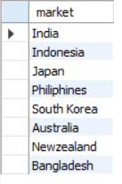
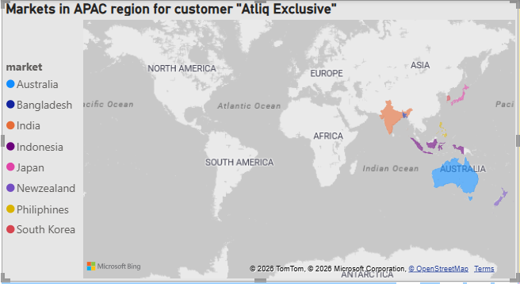
1. Provide the list of markets in which customer "Atliq Exclusive" operates its business in the APAC region.
For customer Atliq Exclusive, it operates in 8 markets in the APAC region.

Slide 3
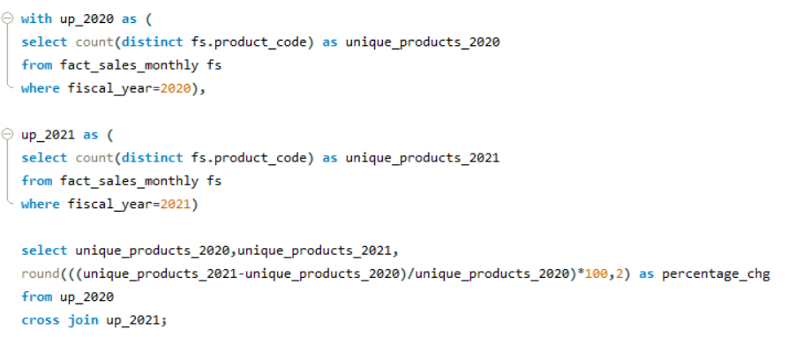
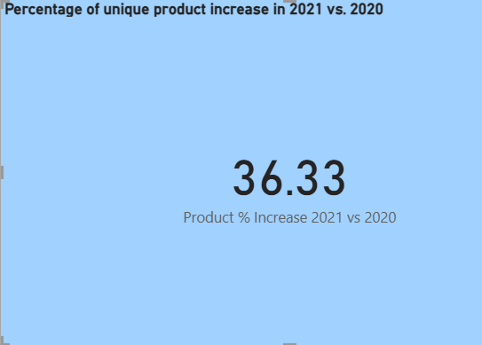

2. What is the percentage of unique product increase in 2021 vs. 2020?
Compared to 2020, there has been 36.33 % increase in the number of unique products in 2021.

Slide 4
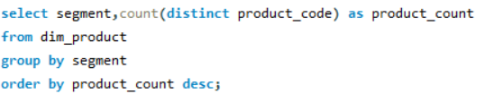
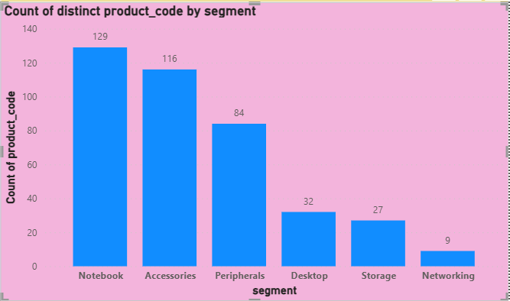
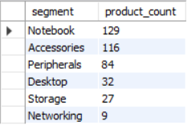
3. Provide a report with all the unique product counts for each segment and sort them in descending order of product counts.
There are 6 segments, out of which maximum products are for Notebook and minimum products are for Networking.

Slide 5
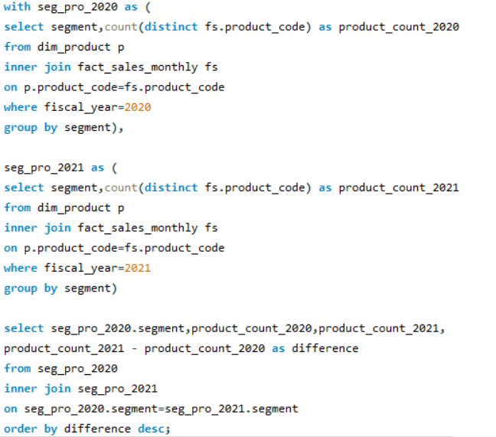
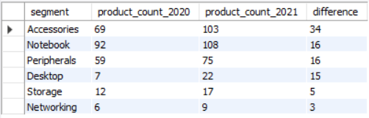
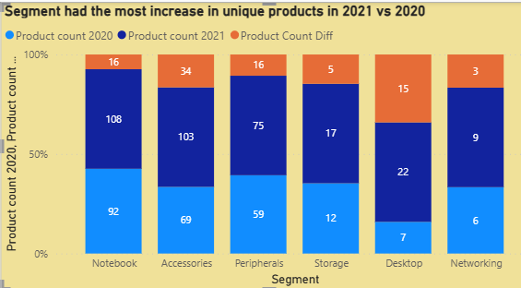
4.Which segment had the most increase in unique products in 2021 vs 2020?
Accessories segment has the most product increase in 2021 compared to 2020

Slide 6
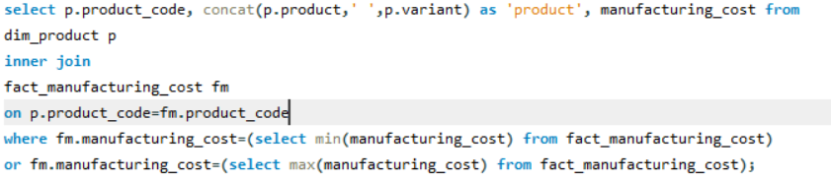

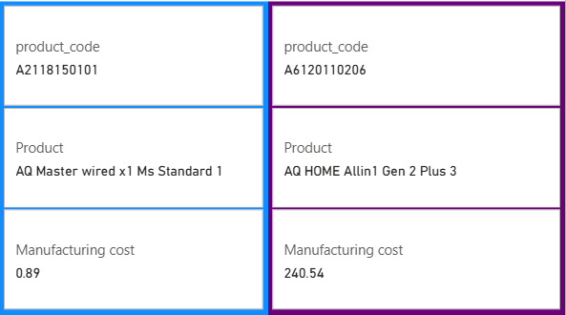
5. Get the products that have the highest and lowest manufacturing costs.
The product codes A2118150101 and A6120110206 having the minimum and maximum manufacturing costs respectively.

Slide 7
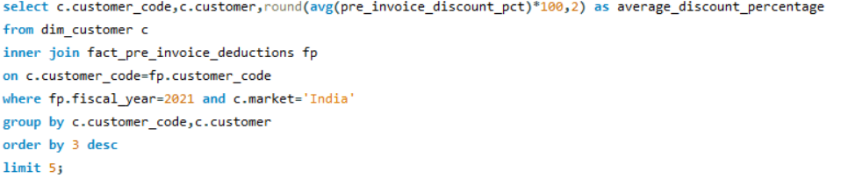
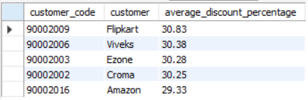
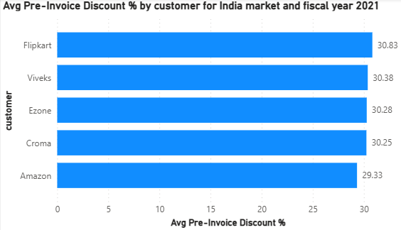
6. Generate a report which contains the top 5 customers who received an average high pre_invoice_discount_pct for the fiscal year 2021 and in the Indian market.
In Indian market, for fiscal year 2021, above 5 customers had received high discounts.

Slide 8
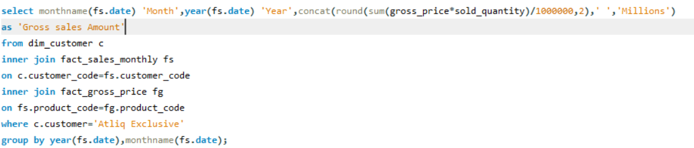
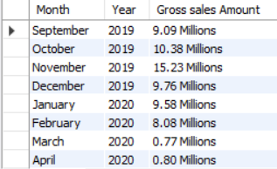
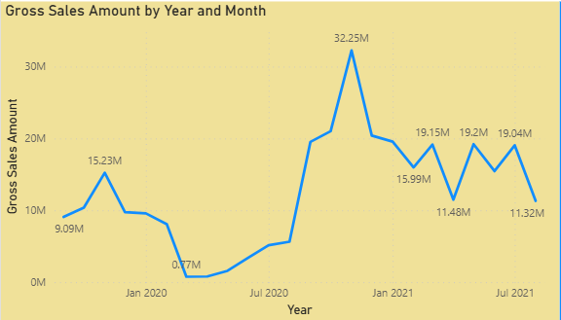
7. Get the complete report of the Gross sales amount for the customer “Atliq Exclusive” for each month.
Sales were down in the first half of 2020 due to COVID but picked up later the same year, the sales were much better in 2021.

Slide 9
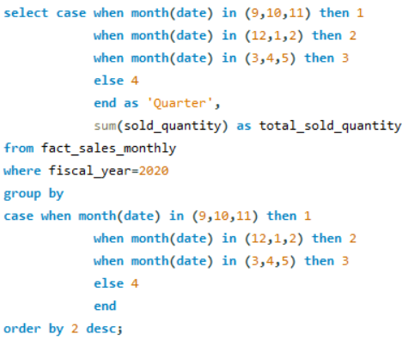
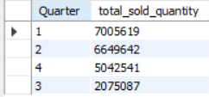
8. In which quarter of 2020, got the maximum total_sold_quantity?
As fiscal year of Atliq starts from September instead of April, we have to do the quarter calculation respectively, we can conclude that the first quarter(September, November, December) has the most quantity of items sold whereas third quarter(March, April, May) has the least quantity of items sold.

Slide 10
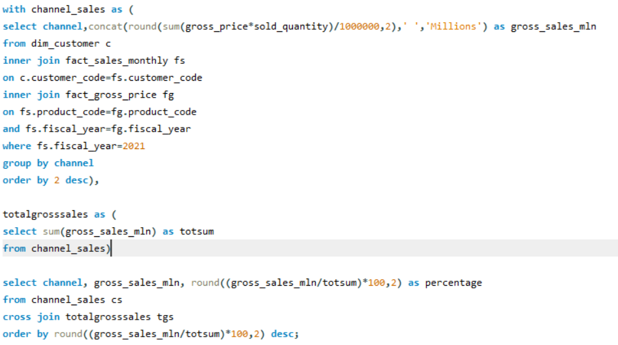

9. Which channel helped to bring more gross sales in the fiscal year 2021 and the percentage of contribution?
In fiscal year 2021, Retailer channel has the most gross sales, around 73.23 %.

Slide 11
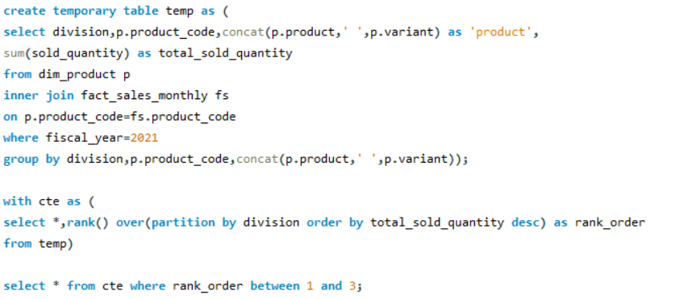
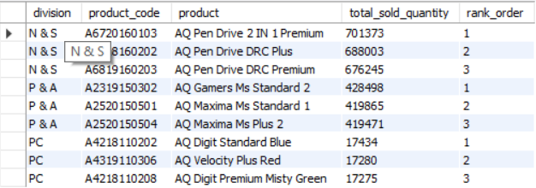
10. Get the Top 3 products in each division that have a high total_sold_quantity in the fiscal_year 2021?

Slide 12
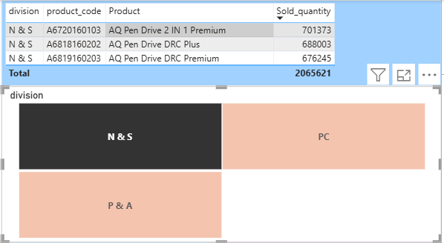
In fiscal year 2021, the product AQ Pen Drive 2 IN 1 Premium has been sold the most, 701373 times.

